Slide 1

Road Traffic Accident
Analysis & Prediction
A Data-Driven Approach using Machine Learning

Slide 2


Abstract
Project Aim & Scope
Methodology & Results
This project analyzes road traffic data to identify key factors influencing accident severity. We employ an end-to-end data pipeline, from acquisition to predictive modeling, aimed at supporting decision-making for safer road infrastructure.
Using algorithms like Logistic Regression, SVM, and Random Forest, we achieved ~98% predictive accuracy. The Random Forest model was selected for deployment due to its robustness and interpretability regarding weather and road type impacts.

Slide 3

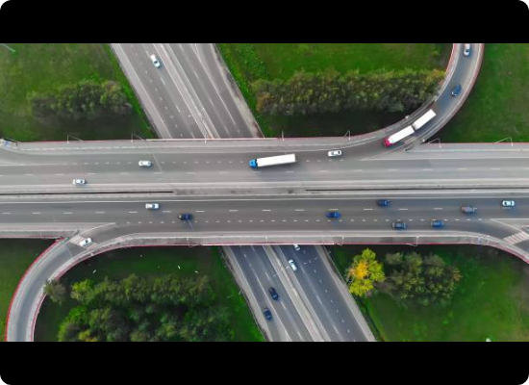
Introduction: The "Churn" of Road Safety
In this context, "Churn" refers to behavioral avoidance. Just as customers leave a service, road users avoid specific routes due to perceived danger.
High-severity zones, adverse weather (fog/rain), and poor lighting trigger this reaction. Analyzing these patterns helps authorities identify environmental factors that force users to "churn" or alter their travel behavior.

Slide 4






Problem Statement & Scope
Rising Severity
Data Gap
Predictive Goal
Despite infrastructure advancements, accident frequency and severity remain critical public safety concerns globally.
Traditional manual analysis is insufficient. There is a critical need for data-driven approaches to handle large-scale datasets.
The project aims to build models estimating severity based on environmental, temporal, and roadway features.

Slide 5
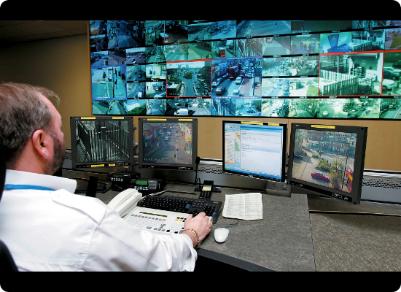
Review of Existing Systems
Limitations of Current Methods
•
Manual Reporting: Prone to human error, incomplete data, and lacks real-time insights.
•
CCTV Surveillance: Requires continuous human monitoring and suffers from blind spots during poor weather.
•
GIS Mapping: Identifies static hotspots but fails to predict dynamic severity probabilities.
•
Basic Statistics: Correlation and frequency analysis cannot capture complex, non-linear relationships.

Slide 6
The Shift to Machine Learning
"
"Ensemble methods like Random Forest outperform traditional linear models when dealing with heterogeneous accident data."
— Literature Findings

Slide 7
Methodology Pipeline
Acquisition
EDA
Encoding
Modeling
Evaluation
Kaggle Dataset
(AccidentsBig.csv)
Outlier Detection
& Missing Values
Categorical to
Numerical
RF, SVM, KNN,
LogReg, DT
Accuracy &
Feature Importance

Slide 8
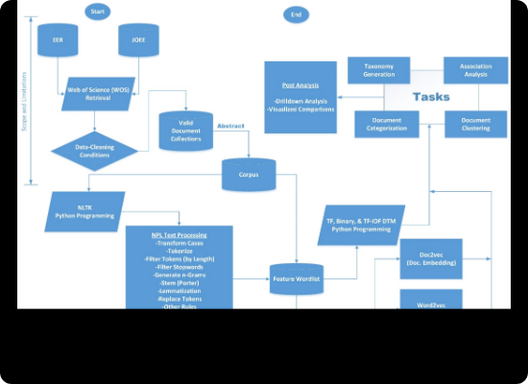
Exploratory Data Analysis (EDA)
Key Preprocessing Steps
Missing Data: Handled using forward fill (numeric) and mode imputation (categorical) to preserve data integrity.
Outliers: Detected in 'Number of Vehicles' and 'Casualties'. Retained as they represent meaningful high-severity events.
Encoding: Converted text labels (Road Type, Weather) into numerical formats for ML compatibility.
Correlation: Heatmaps revealed weak linear correlations, necessitating non-linear models like Random Forest.

Slide 9
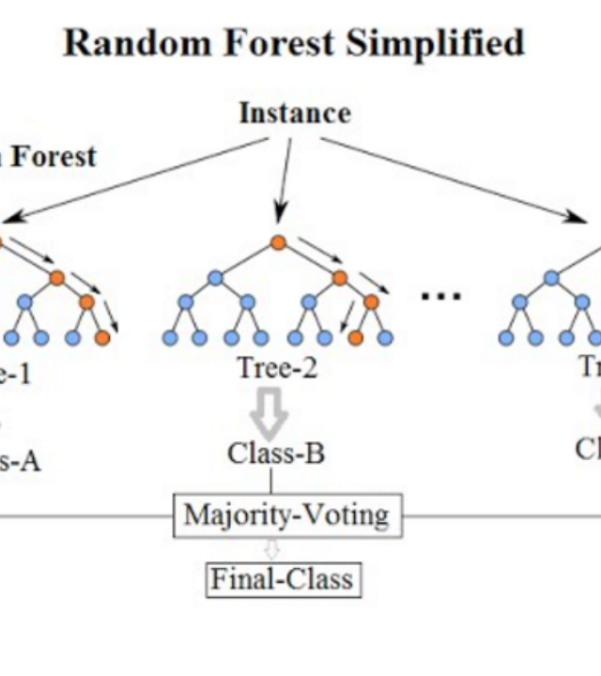
Selected Model: Random Forest
Why Random Forest?
Random Forest constructs multiple decision trees during training. It outputs the class selected by the majority of the trees (mode of classification).
Key Advantages:
- Handles non-linear relationships effectively.
- Robust to noise and outliers (common in accident data).
- Provides clear Feature Importance scores.
- Reduces the risk of overfitting compared to single Decision Trees.

Slide 10
Data Splitting Strategy
80%
20%
Training Data
Testing Data

Slide 11
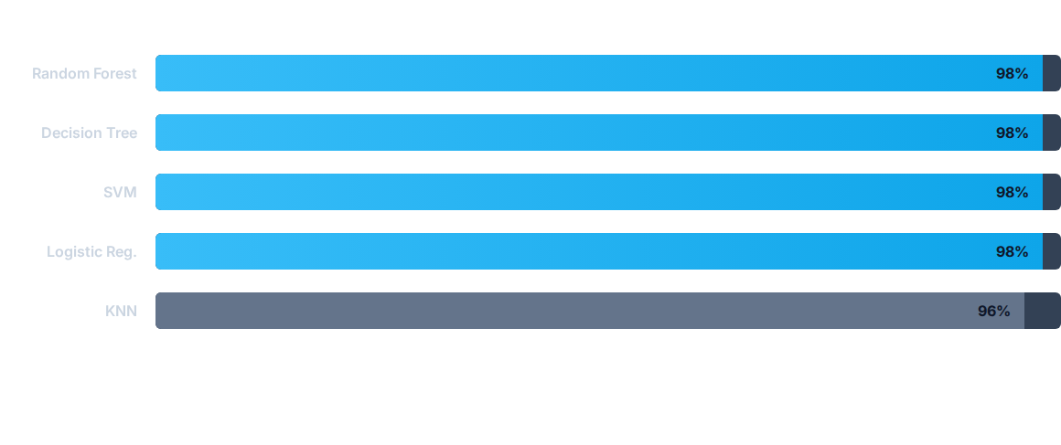
Model Performance Comparison
All models performed exceptionally well, but Random Forest offers better stability.

Slide 12





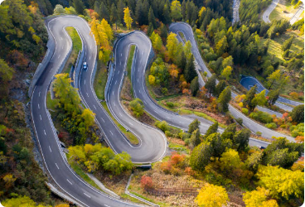
Identified Risk Factors
Time of Day
Weather Conditions
Road Type
Accidents peak during morning (8-10 AM) and evening (4-6 PM) rush hours.
Poor visibility and wet roads significantly increase the probability of severe accidents.
Single and dual carriageways see higher incident rates compared to slip roads.

Slide 13

Feature Importance Analysis
Time of Accident (40%)
Road Type (30%)
Weather (30%)
The Random Forest analysis revealed that temporal factors and physical road characteristics are the strongest predictors of severity.

Slide 14


Conclusion
Project Success
Key Takeaways
The project successfully demonstrated that machine learning can accurately predict accident severity. The preprocessing pipeline effectively cleaned noisy data, allowing models to identify meaningful patterns.
Random Forest emerged as the optimal model for deployment. The insights provided can directly support traffic authorities in optimizing resource allocation and implementing proactive safety measures.

Slide 15
Q&A
Thank you for your attention.

Slide 16







Image Sources
https://media.istockphoto.com/id/1413625824/photo/the-drone-flies-over-the-track-during-traffic-with-many-interchanges-in-different-directions.jpg?s=612x612&w=0&k=20&c=pNu-XrlJIXKvilFNEDeEGJrUSYQg_DZN45shM6b2csg=
Source: www.istockphoto.com
https://media.extron.com/public/img/mktg/trafficmgmt.jpg
Source: www.extron.es
https://pub.mdpi-res.com/sustainability/sustainability-13-10856/article_deploy/html/images/sustainability-13-10856-g001.png?1632929122
Source: www.mdpi.com
https://miro.medium.com/1*i0o8mjFfCn-uD79-F1Cqkw.png
Source: williamkoehrsen.medium.com
https://static.vecteezy.com/system/resources/thumbnails/070/017/856/small/urban-rush-hour-traffic-scene-at-sunset-busy-city-street-with-cars-and-taxis-photo.jpg
Source: www.vecteezy.com
https://static.vecteezy.com/system/resources/previews/060/002/828/large_2x/driving-in-heavy-rain-at-night-in-new-york-city-free-photo.jpg
Source: www.vecteezy.com

Slide 17



Image Sources
https://media.istockphoto.com/id/1181495500/photo/winding-mountain-road-maloja-pass-swiss-alps.jpg?s=612x612&w=0&k=20&c=b6aHyrqXWCRfxvsuVT589tOjOYDVUaEKbQZ3hsHnnrE=
Source: www.istockphoto.com
https://scwcontent.affino.com/AcuCustom/Sitename/DAM/014/connected_cars_Adobe.jpg
Source: www.smartcitiesworld.net

